Slide 1

Censorship and Narrative Control A Textual and comparative Analysis of Florida’s Banned Books
Grace O’Malley

Slide 2

Agenda Items
Research Motivation
Data & Methods
Analysis & Findings
Conclusion

Slide 3
Problem Statement

Slide 4

Why Study book banning?
Censorship is on the Rise
Full-text book content encompasses the entire text of banned books, providing a comprehensive view for analysis.
Narrative Driven
Bans often rely on superficial descriptors – attention grabbing lines that will elicit an emotional response – often ignoring the full narrative content
Research Gap
This study bridges the research gap between the content of books and the themes that are presented outwardly to the public to fight the proverbial issue of judging a book by its cover

Slide 5
Conceptual framework
Data
49 full book texts
Themes & descriptions from Google Books website
Analysis
Term Frequency (TF & TF-IDF)
Subgroup Comparison (Florida vs. Iowa)
Outputs
Understanding of ideological censorship patterns
Thematic Analysis (Bigrams, Dictionary Analysis, Theme Prevalence)
Machine Learning Modeling (Ridge & XGBoost)
22 banned
27 unrestricted
Identify diverging, converging, or isolated regional patterns in censorship
Fig. 1 – Research Conceptual Framework

Slide 6
Data & Methodology

Slide 7

Data sources & sampling strategy
Florida
Wuthering Heights
Iowa
The Picture of Dorian Gray
The Taming of the Shrew
Native Son
Leonardo Da Vinci
The Road
The Pirate
The Dark Tower
Redeemed
Chain Reaction
The Heir
The Talisman
The Great Return
Smoke
Glass
Redeemed
The Bridge
Dead End
Christine
Dreamland
Total Data Set
The dataset consists of 22 banned books, 27 unrestricted books, Google Books themes (subjects) and descriptions.
Full Book Texts
All book texts were downloaded from Project Gutenberg through R Scripts. The banned books were selected by random sampling from the list of book titles available through the Project Gutenberg library.*
Google Books
Book themes and descriptions were pull via ChatGPT query and validated against the Google Books website by sampling ~10% of themes and descriptions and directly comparing for accuracy.
Fig. 2 & 3 – Florida (left) and Iowa (right) Banned Book Samples

Slide 8
Methodology
Data Cleaning
HTML, stopwords, punctuation
Tokenization, Lemmatization
Feature Extraction
TF & TF-IDF
Bigram co-occurrence
Comparative Analysis
Comparative Analysis
Thematic Analysis
Predictive Modeling
Ridge Logistic Regression
XGBoost
Theme Dictionary
Gutenberg metadata
Name Entity Recognition
Regional Analysis
Review
Initial data cleaning required multiple passes
Feature extraction brough to light data issues that had to be corrected
Comparative analysis revealed additional data cleaning requirements
Modeling proved
Fig. 4 – Methodology Flow Chart

Slide 9
Findings by technique

Slide 10
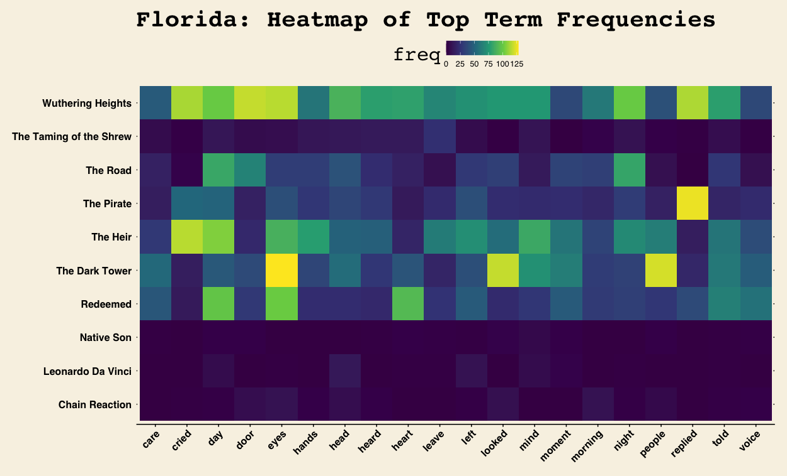
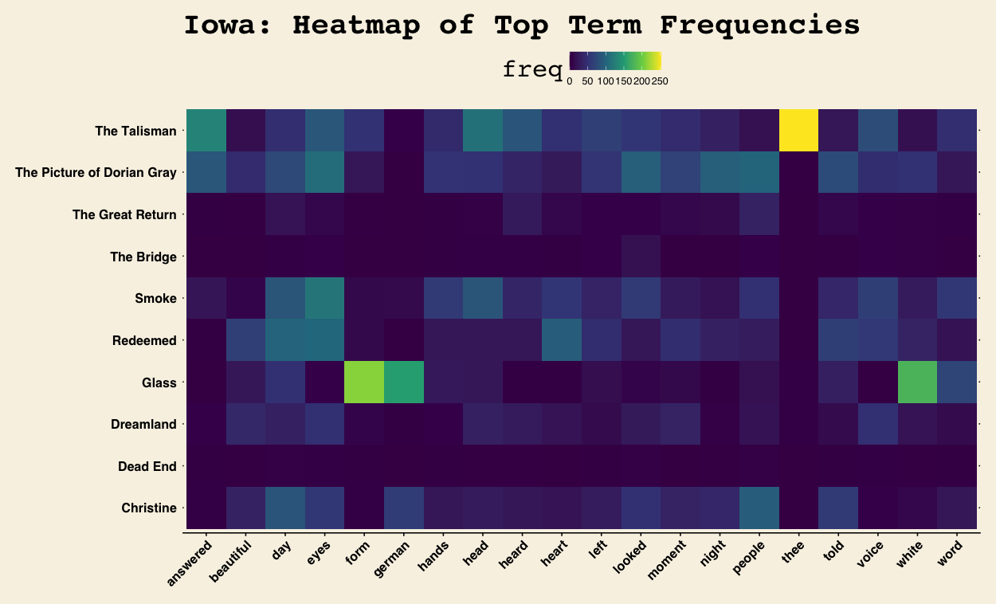
Term frequency: Florida vs. Iowa
Florida
Emotional focus
High frequency words that indicate emotions like (eyes, told, heart)
Iowa
Historical / technical focus
Technical specific terms (platoon, engraved, enamelled)
Conclusion
This suggests differences in underlying ban themes where emotional or affective theme bans dominate in Florida and technical or epistemic theme bans are prevalent in Iowa
Fig. 5 & 6 – Florida (top) and Iowa (bottom) Term Frequency Heatmaps

Slide 11
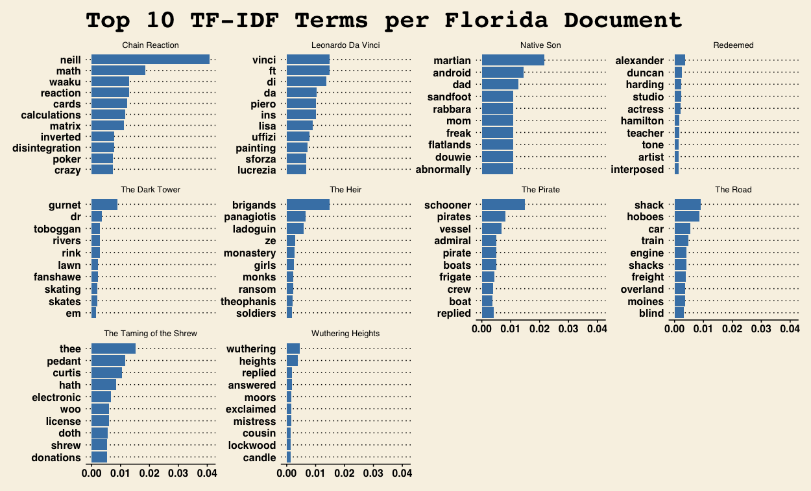
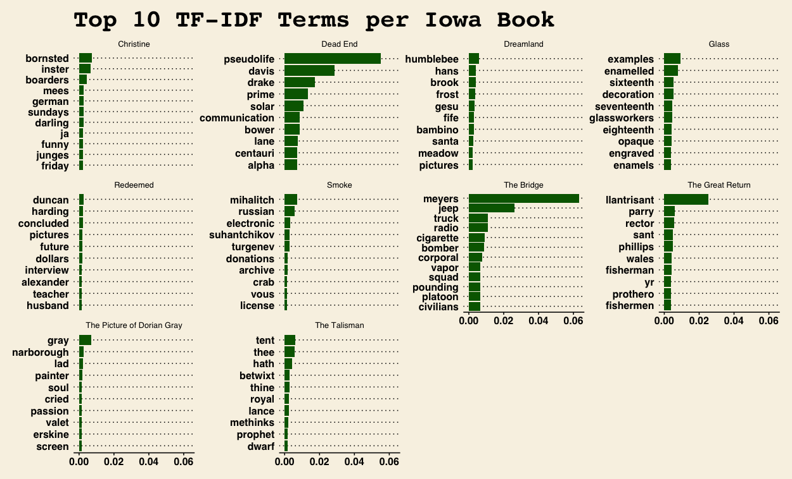
TF-IDF: High signal words
Florida
Identity, family, and conflict markers
Reaction, brigands, mom, dad, crazy, license
Iowa
Historically / technically specific markers
Hyaluronic, seventeenth, eighteenth, engraved, parry
Conclusion
TF-IDF supports the previously identified thematic differences that are materializing. Florida shows a propensity to ban books that have words that center on identity, family, and conflict, while Iowa bans seem to be aimed at more technical or historical texts.
Fig. 7 & 8 – Florida (top) and Iowa (bottom) Top TF-IDF Signal Words

Slide 12
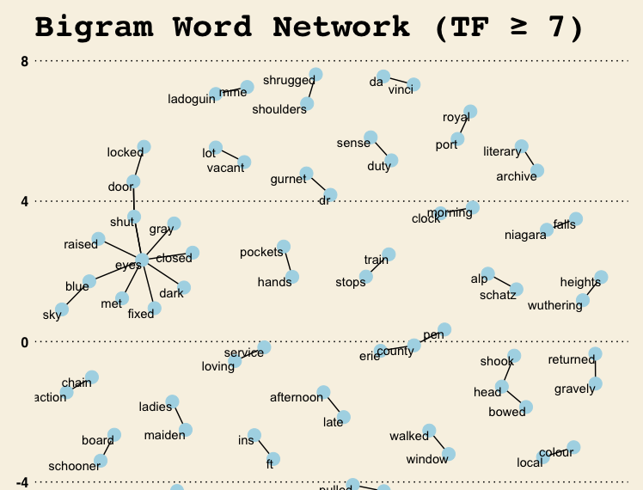
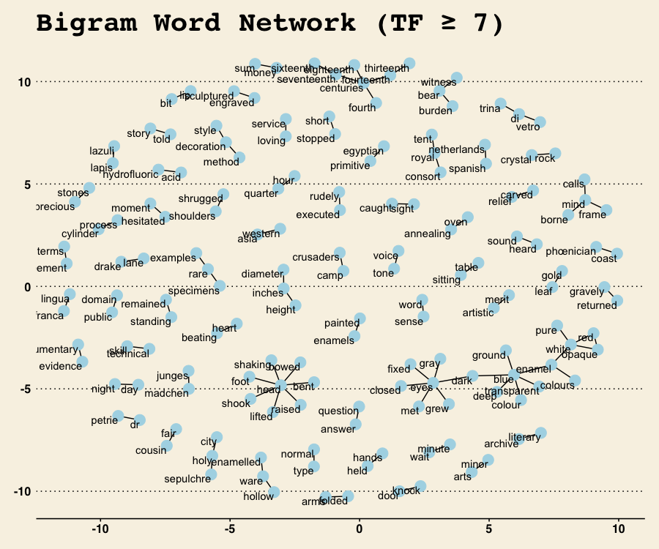
Bigram network analysis
Florida
Emotional and interpersonal connections
Shrugged shoulders, eyes fixed, eyes raised, eyes closed, loving service
Iowa
Dense technical and historical connections
Rare specimens, rare examples, Phoenician coast, Spanish Netherlands
Conclusion
This supports the thematic ban divergence between Florida and Iowa. Banned books in Florida continues to exhibit emotional and interpersonal themes and banned books in Iowa continue with technical and historical overtures.
Fig. 9 & 10 – Florida (top) and Iowa (bottom) Bigram Networks

Slide 13
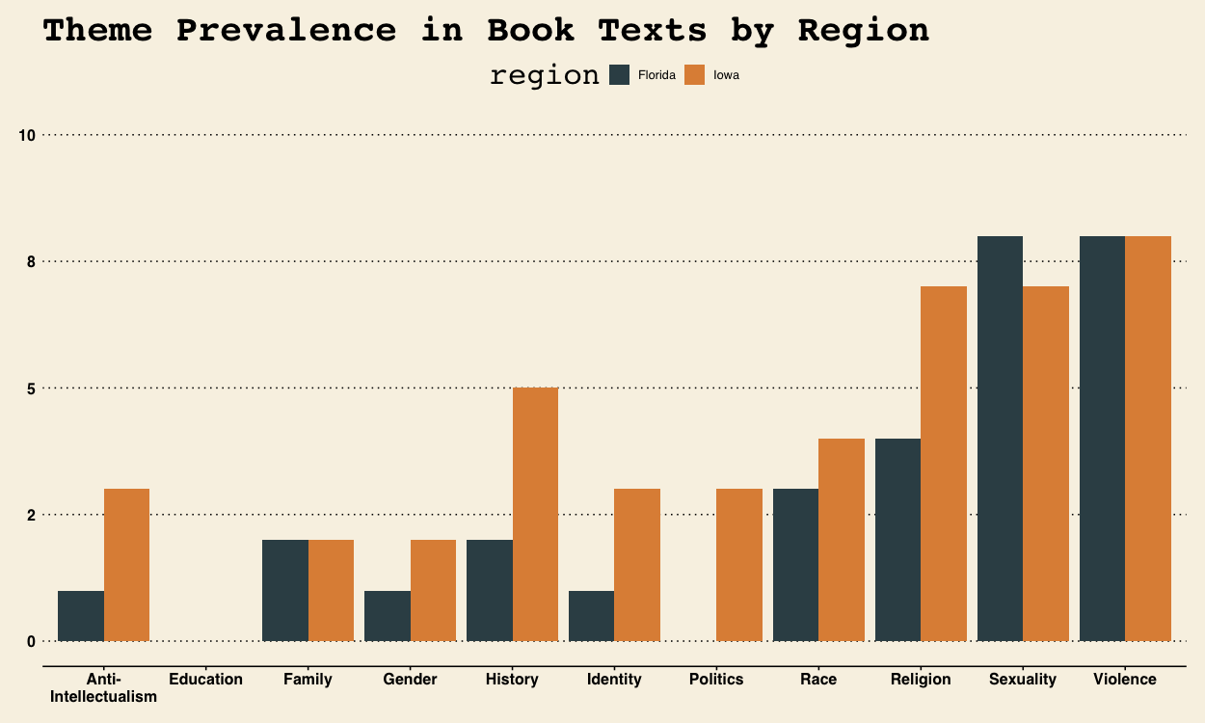
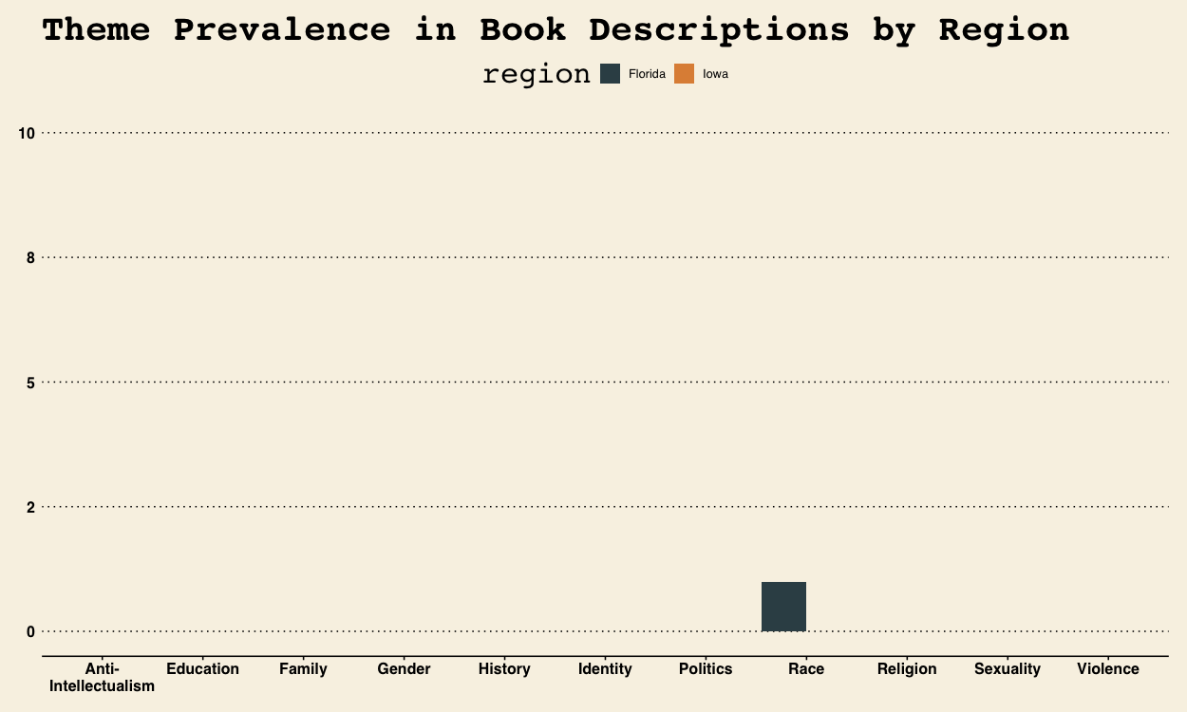
Thematic Dictionary Application
Top Themes
Violence
Sexuality
Gender
Religion
Conclusions
There are major disconnects between the themes listed on the Google Books website and the themes deduced from thorough textual analysis.
Publisher discretion for thematic assignment shields potentially controversial themes from scrutiny – however this could be borne from positive or negative intention.
Fig. 11 & 12 –Textual (top) and Description (bottom) Theme Prevalence

Slide 14
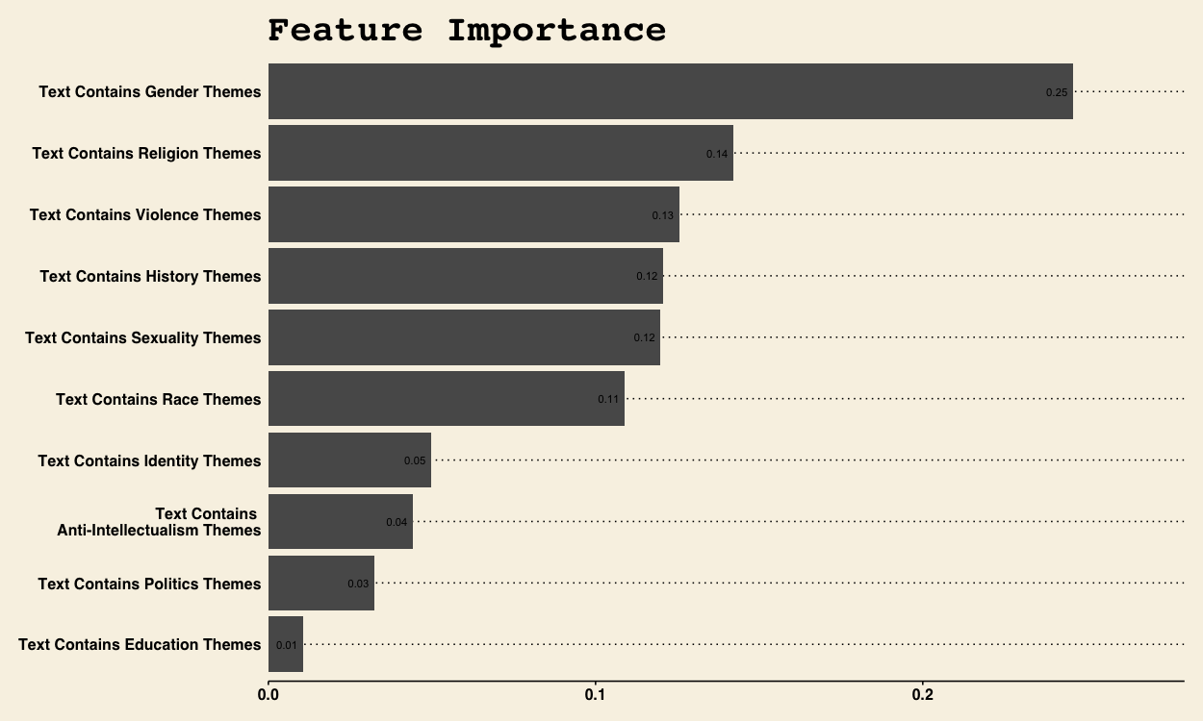
Predictive Modeling
Model Performance
Iteration | Training |  |  |  |  | Testing
Model | AUC | Accuracy | Sensitivity | Specificity | F1 Score | AUC | Accuracy | Sensitivity | Specificity | F1 Score
Ridge | 0.890 | 0.775 | 0.750 | 0.800 | 0.769 | 0.524 | 0.600 | 0.714 | 0.333 | 0.714
XGBoost | 0.859 | 0.750 | 0.750 | 0.800 | 0.737 | 0.571 | 0.700 | 0.857 | 0.333 | 0.800
Model Performance
Excellent training performance
Marginal performance on testing data
Conclusions
There isn’t conclusive variable markers to create a predictive model that is significantly better than chance.
The sharp performance decrease when introduced to testing data is indicative of overfitting during training.
This is a likely a result of the limitations of training data being constrained by the texts available through Project Gutenberg. Model performance could be enhanced through a wider testing sample.
Poor model performance does not take away from the positive identification of themes – simply means we do not have refined enough indicators for accurate predictions
Fig. 14 & 15 – Feature Importance (top) and Model Performance (bottom)

Slide 15
Conclusions & Future Research

Slide 16

Research Conclusions
Censorship is not arbitrary
Clear themes emerged through textual analysis of banned books in both municipalities
Thematic description incongruence
Stark differences between published themes and themes deduced from thorough textual analysis are apparent
Predictive analysis needs further development
While clear themes have been identified, there are not strong enough variables to predict much better than random chance
Florida’s bans center on gender and LGBTQ+ content
Iowa’s bans center on anti-intellectualism, identity, and history
This could be active suppression based on animus to suppress controversial topics or shield books from controversy by using overly broad theme associations
This is a limitation of the data used for this study, but will be addressed in future study

Slide 17
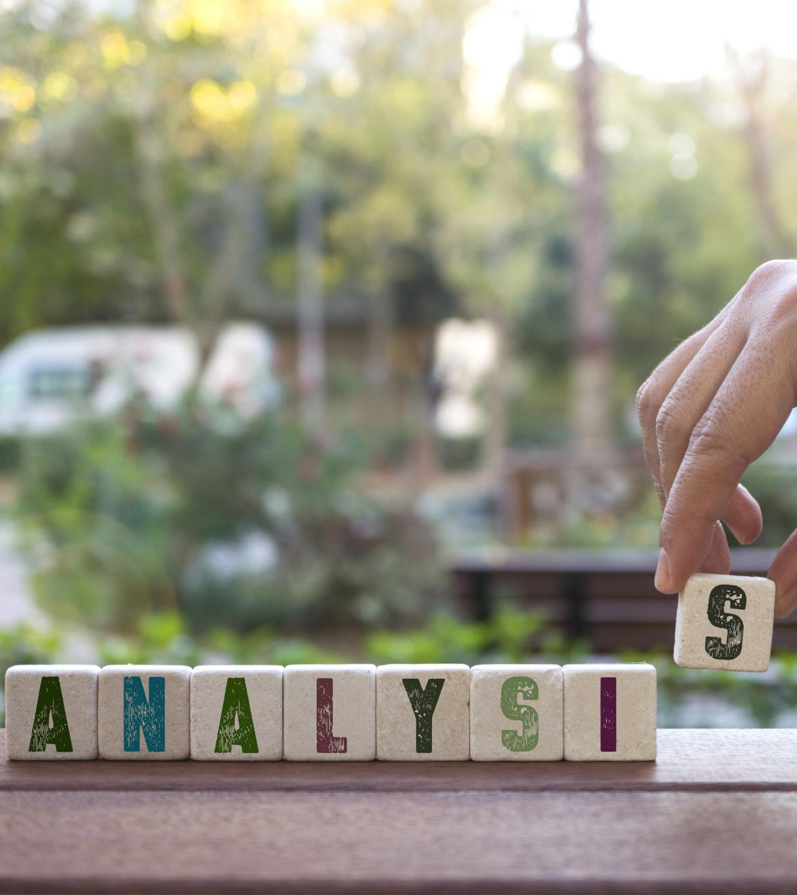
The Way Forward
Expand
Data Types
Collect Text Data
Model Development
Add more regional and political dimensions
Collect data on voting behavior, regional education policies, and political sentiments
Add more textual sources
Model expansion
Expand corpora by requesting access to texts through legal means
Expand thematic study to include other issues – bodily autonomy, disabilities, immigration, economic justice
Begin semi- and self-supervised model training on larger corpora with human in the loop guardrails

Slide 18
Appendices

Slide 19
Appendix A – Full Book list
Title | Author | Group | Region | Banned
Chain Reaction | Boyd Ellanby | Training | Florida | Y
Leonardo Da Vinci | Maurice W. Brockwell | Training | Florida | Y
Native Son | T. D. Hamm | Training | Florida | Y
Redeemed | George Sheldon Downs | Training | Both | Y
The Dark Tower | Phyllis Bottome | Training | Florida | Y
The Heir | Sydney C. Grier | Training | Florida | Y
The Pirate | Captain Frederick Marryat | Training | Florida | Y
The Road | Jack London | Training | Florida | Y
The Taming of the Shrew | William Shakespeare | Training | Florida | Y
Wuthering Heights | Emily Brontë | Training | Florida | Y
Christine | Elizabeth Von Arnim | Training | Florida | Y
Dead End | Wallace Macfarlane | Training | Florida | Y
Dreamland | Julie M. Lippmann | Training | Florida | Y
Glass | Edward Dillon | Training | Florida | Y
Redeemed | George Sheldon Downs | Training | Both | Y
Smoke | Ivan Sergeevich Turgenev | Training | Florida | Y
The Bridge | G. G. Revelle | Training | Florida | Y
The Great Return | Arthur Machen | Training | Florida | Y
The Picture of Dorian Gray | Oscar Wilde | Training | Florida | Y
The Talisman | Sir Walter Scott | Training | Florida | Y
Title | Author | Group | Region | Banned
A Modest Proposal | Jonathan Swift | Training | N/A | N
Anna Karenina | Leon Tolstoy | Training | N/A | N
Crime and Punishment | Fyodor Dostoyevsky | Training | N/A | N
Heart of Darkness | Joseph Conrad | Training | N/A | N
Little Women | Louisa May Alcott | Training | N/A | N
Making the Nine | Albertus T. Dudley | Training | N/A | N
Metamorphosis | Franz Kafka | Training | N/A | N
Middlemarch | George Eliot | Training | N/A | N
Narrative of the Life of Frederick Douglass, an American Slave | Frederick Douglass | Training | N/A | N
Oliver Twist | Charles Dickens | Training | N/A | N
Pride and Prejudice | Jane Austen | Training | N/A | N
Romeo and Juliet | William Shakespeare | Training | N/A | N
Sense and Sensibility | Jane Austen | Training | N/A | N
Simple Sabotage Field Manual | United States Office of Strategic Services | Training | N/A | N
The Adventures of Sherlock Holmes | Arthur Conan Doyle | Training | N/A | N
The Devil is an Ass | Ben Johnson | Training | N/A | N
The Divine Fire | May Sinclair | Training | N/A | N
The Souls of Black Folk | W. E. B. Du Bois | Training | N/A | N
The Wonderful Wizard of Oz | L. Frank Baum | Training | N/A | N
Ulysses | James Joyce | Training | N/A | N
Title | Author | Group | Region | Banned
A Lost Cause | Guy Thorne | Test | N/A | N
Eli | Heman White Chaplin | Test | N/A | N
Gladiator | Philip Wylie | Test | N/A | N
Officer and Man | Louis Becke | Test | N/A | N
Paradise Lost | John Milton | Test | Florida | Y
The Man in the Iron Mask | Alexandre Dumas | Test | Florida | Y
The Old Dominion | Mary Johnston | Test | N/A | N
The Sentimentalists | George Meredith | Test | N/A | N
The Sun Also Rises | Ernest Hemingway | Test | Florida | Y
The Young Deliverers of Pleasant Cove | Elijah Kellogg | Test | N/A | N
Fig. 16 – Complete Dataset Book Listing

Slide 20
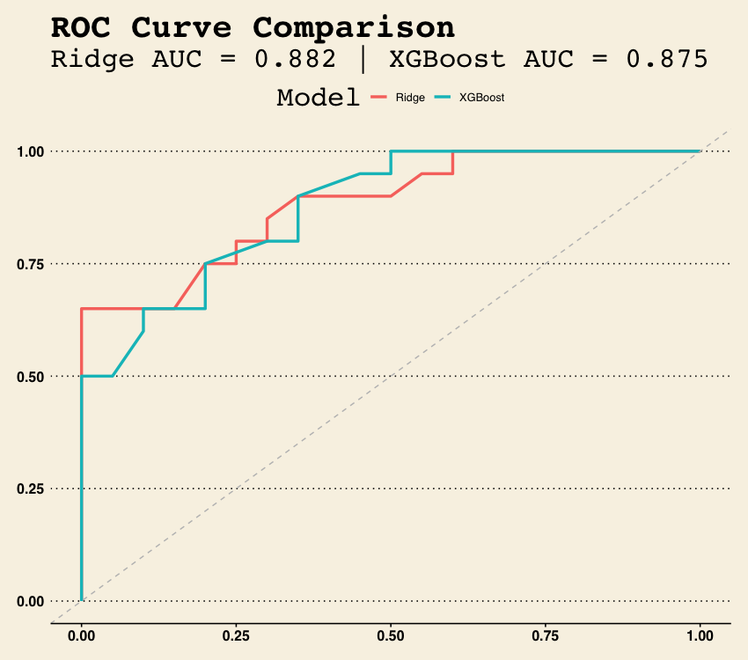
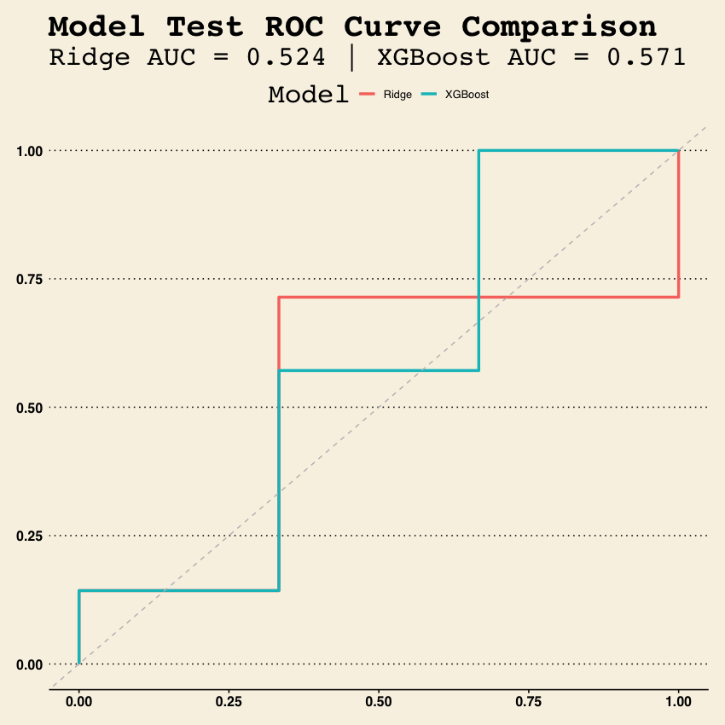
Appendix B – ROC Curves
Fig. 17 & 18 – Training (left) and Testing (right) ROC Comparisons

Slide 21
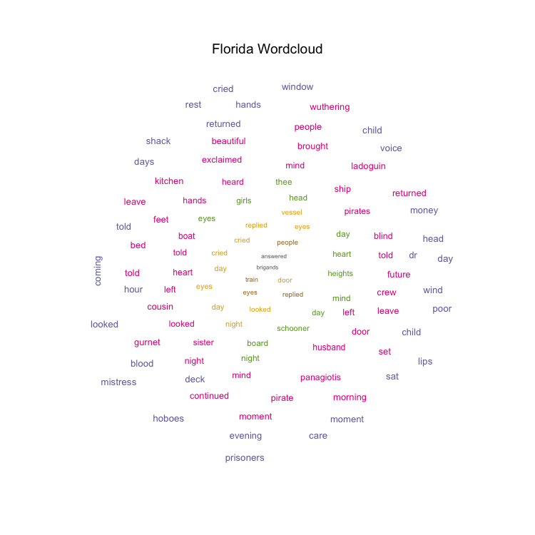
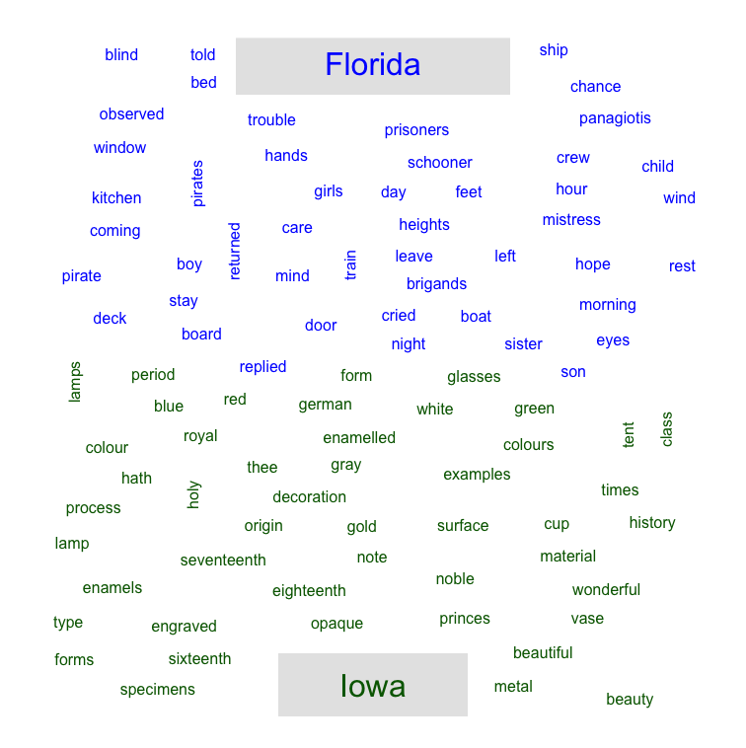
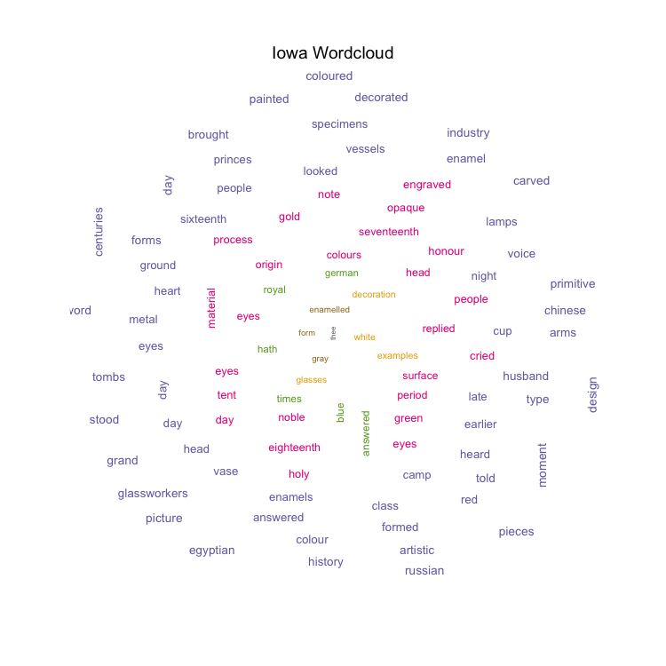
Appendix C – WordClouds
Fig. 19 – Florida TF Wordcloud
Fig. 20 – Combined TF Wordcloud
Fig. 21 – Iowa TF Wordcloud
Fig. 19, 20, & 21 – Florida (left) , Combined (center), & Iowa (right) Wordclouds

Slide 22
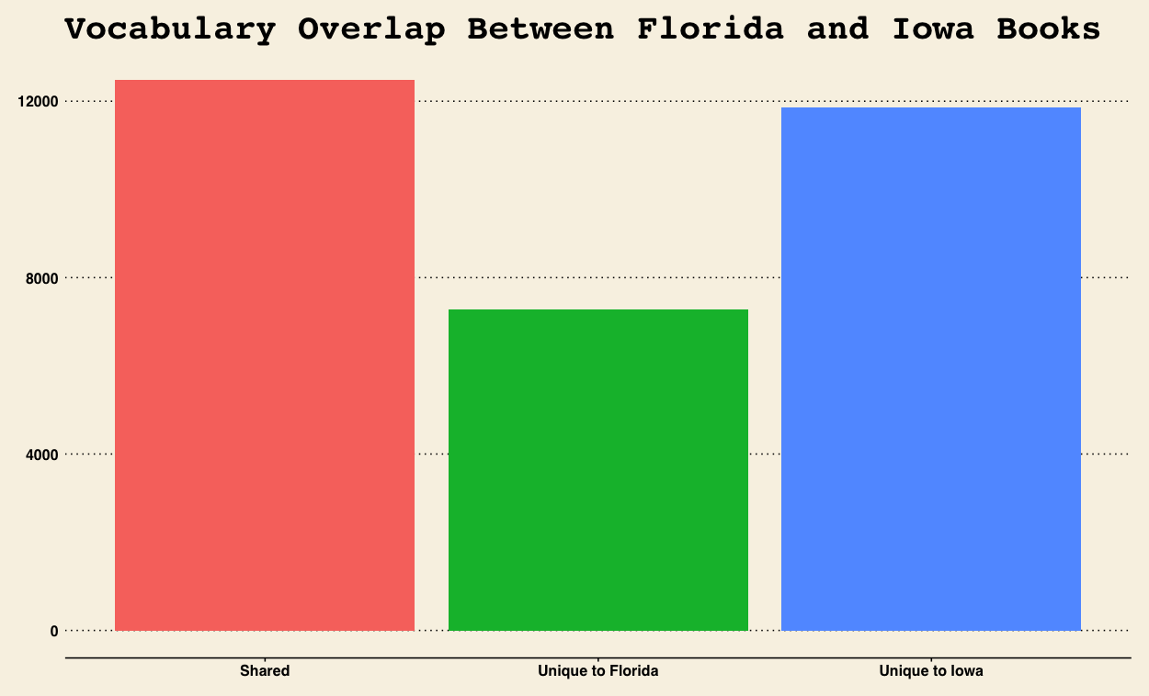
Appendix D – Common Terms
Fig. 22 – Common Terms Bar Chart

Slide 23
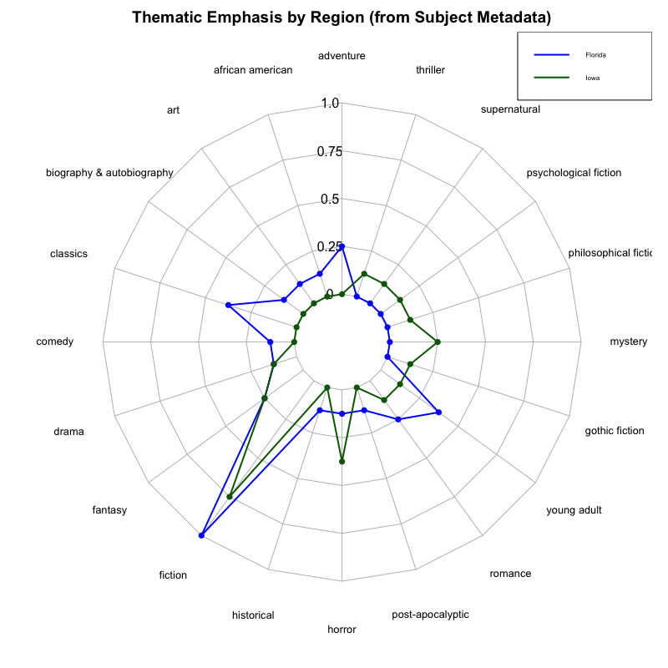
Appendix E – Thematic Radar Plot
Fig. 23 – Thematic Radar Plot by Region

Slide 24
Appendix F – References

